Slide 1

MICRO CREDIT PROJECT
BY ABHISHEK PAI

Slide 2
ACKNOWLEDGMENT
The Dataset and related information was provided by Flip Robo as part internship phase. This entire file package included a dataset with is column understanding to help with project analysis

Slide 3
INTRODUCTION
A Microfinance Institution (MFI) is an organization that offers financial services to low-income populations. MFS becomes very useful when targeting especially the unbanked poor families living in remote areas with not many sources of income.
Many microfinance institutions (MFI), experts, and donors are supporting the idea of using mobile financial services (MFS) which they feel are more convenient and efficient, and cost-saving, than the traditional high-touch model used long to deliver microfinance services.

Slide 4
Conceptual Background of the Domain Problem
Building a model which can be used to predict in terms of a probability for each loan transaction, whether the customer will be paying back the loaned amount within 5 days of insurance of loan. In this case, Label ‘1’ indicates that the loan has been paid i.e. Non- defaulter, while, Label ‘0’ indicates that the loan has not been paid i.e. defaulter.

Slide 5
Analytical Problem Framing
Performing univariate bivariate and multivariate analysis helped a lot to understand the nature of data-based, also performing outliers check and skewness helped to shape data, based that the data was scaled and then principal component was performed.

Slide 6
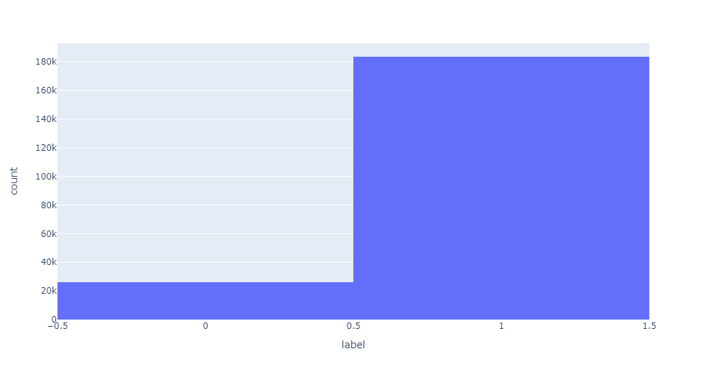
Analyzing target variable
The analysis shows that the data is imbalanced.
Class 1 is more than class 0 which can be an issue while performing ML
Sampling was done to solve this issue

Slide 7
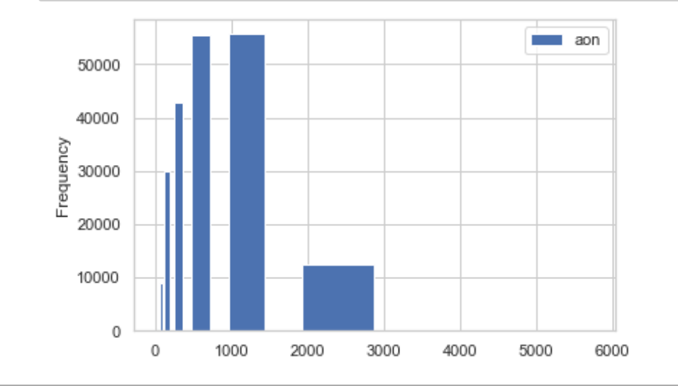
Univariate Analysis
Univariate analysis was performed for columns based on correlation with label

Slide 8
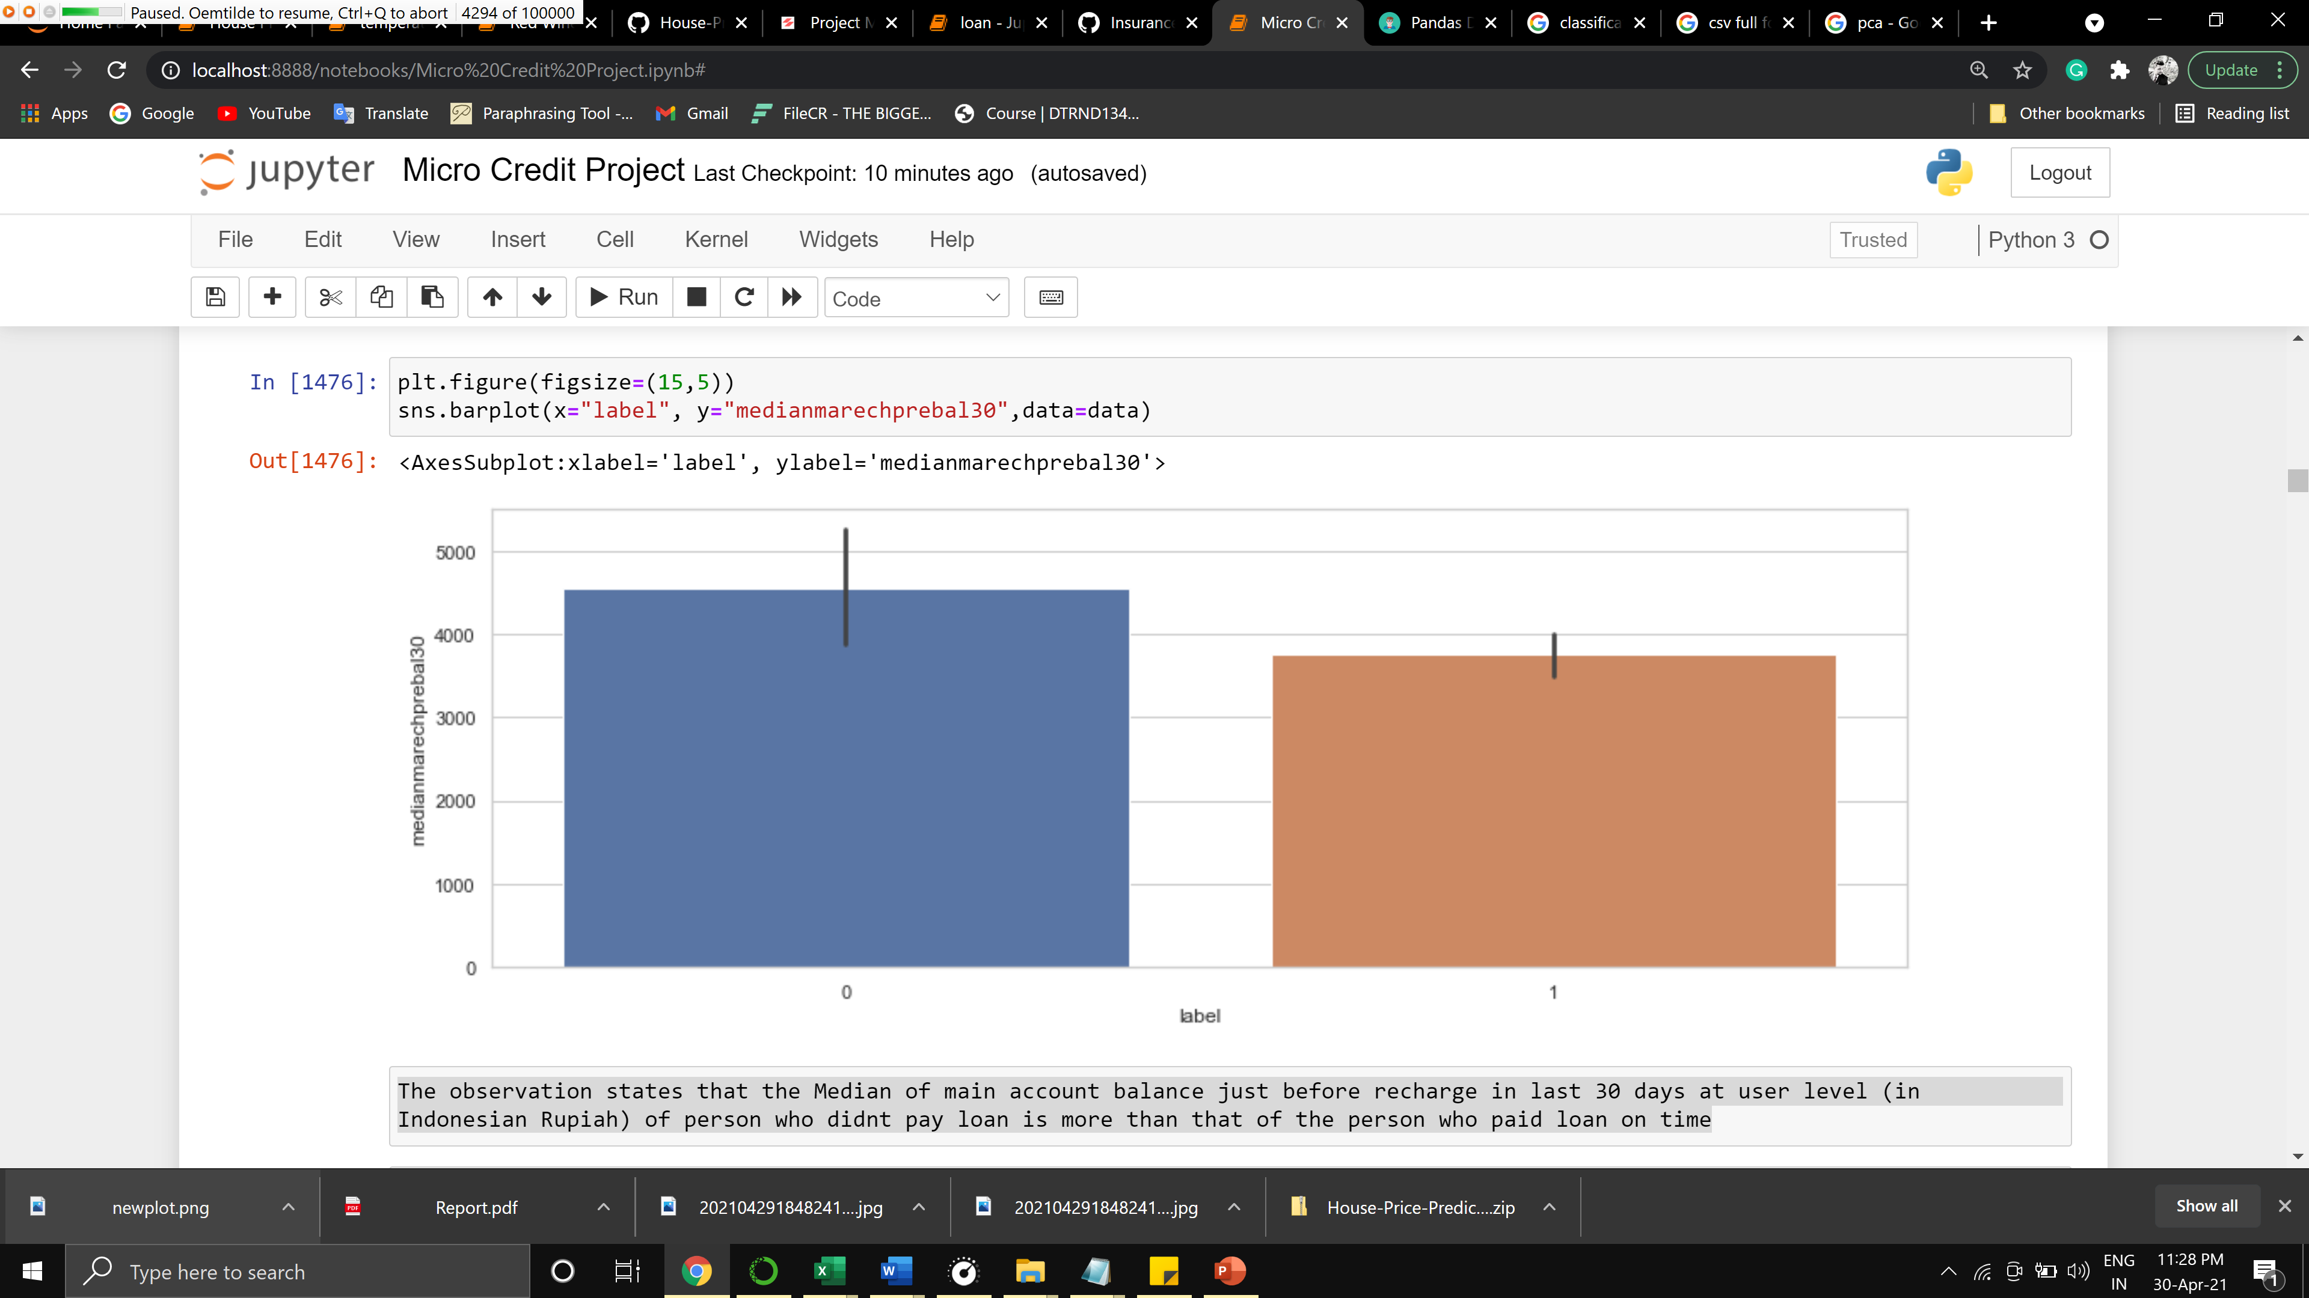
Bivariate Analysis
Bivariate analysis was perform with correlated columns greater than 0.5 threshold

Slide 9
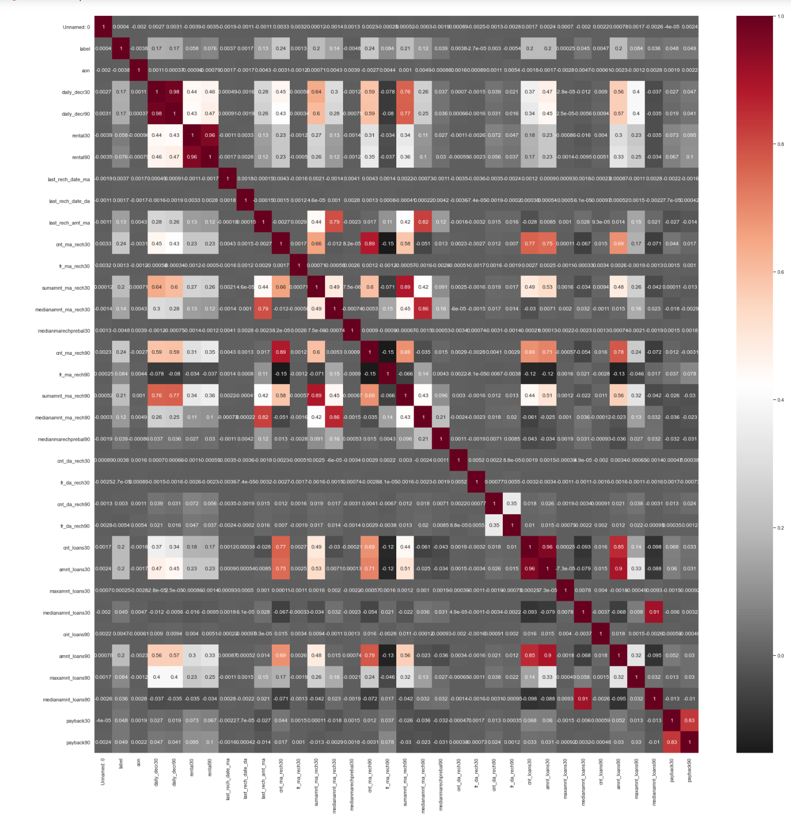
Multivariate Analysis
Multivariate analysis was performed for all columns to find correlation with target variable

Slide 10
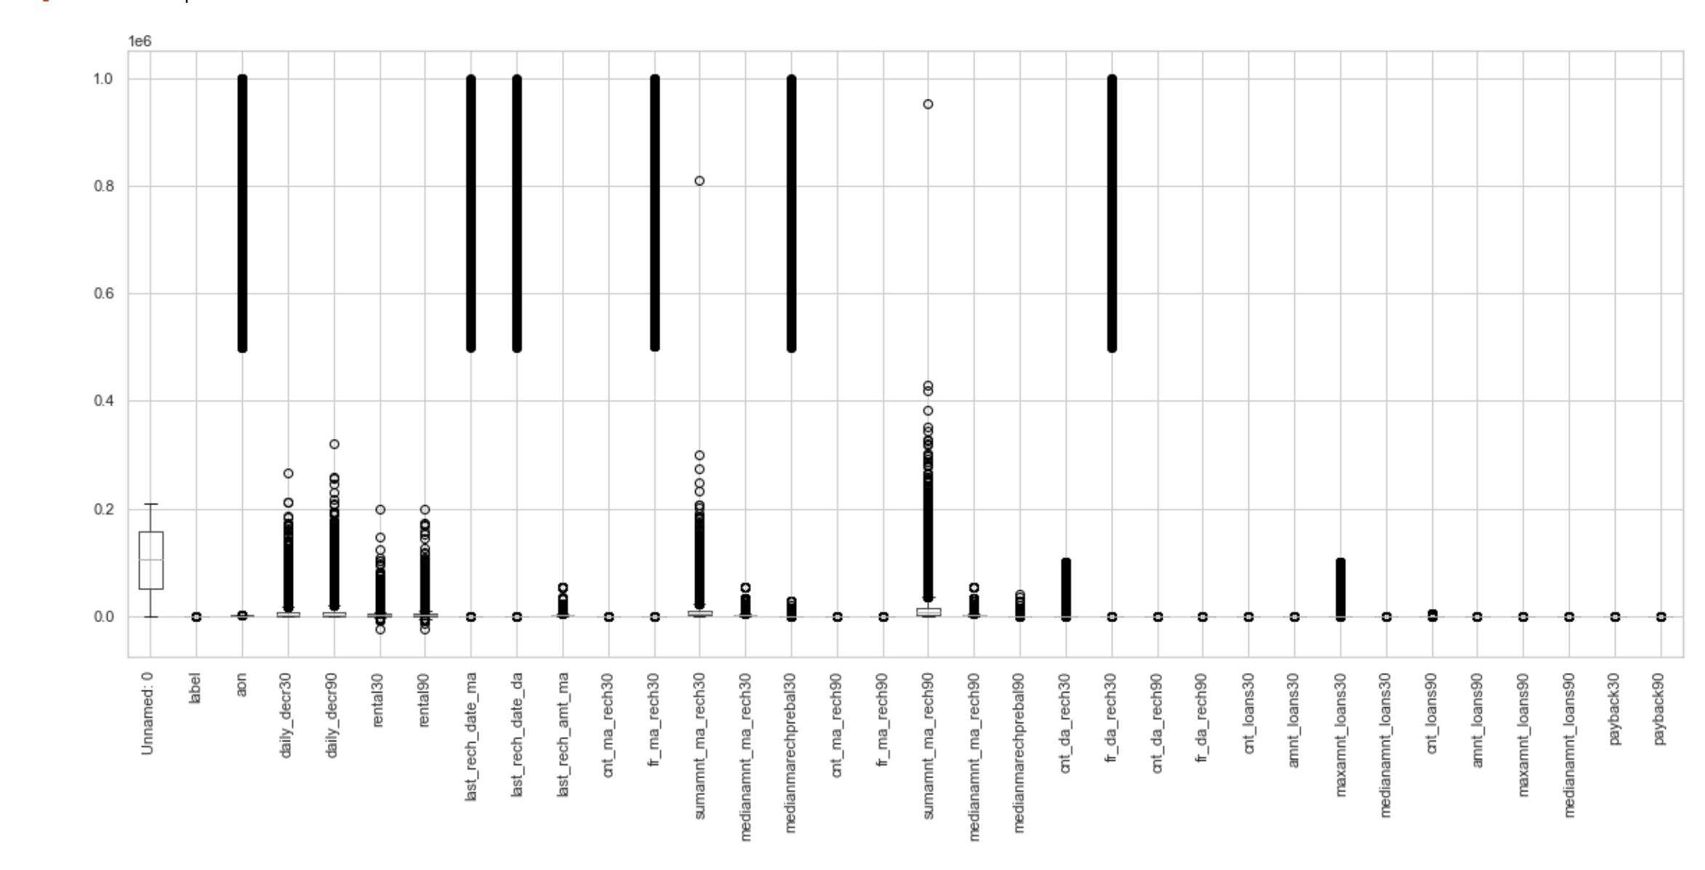
Outlier handling
Outliers where visualized and handled using Boxplot
And later handled using IQR and Zsore Methods
Later Skewness were handled Using square root transform method

Slide 11
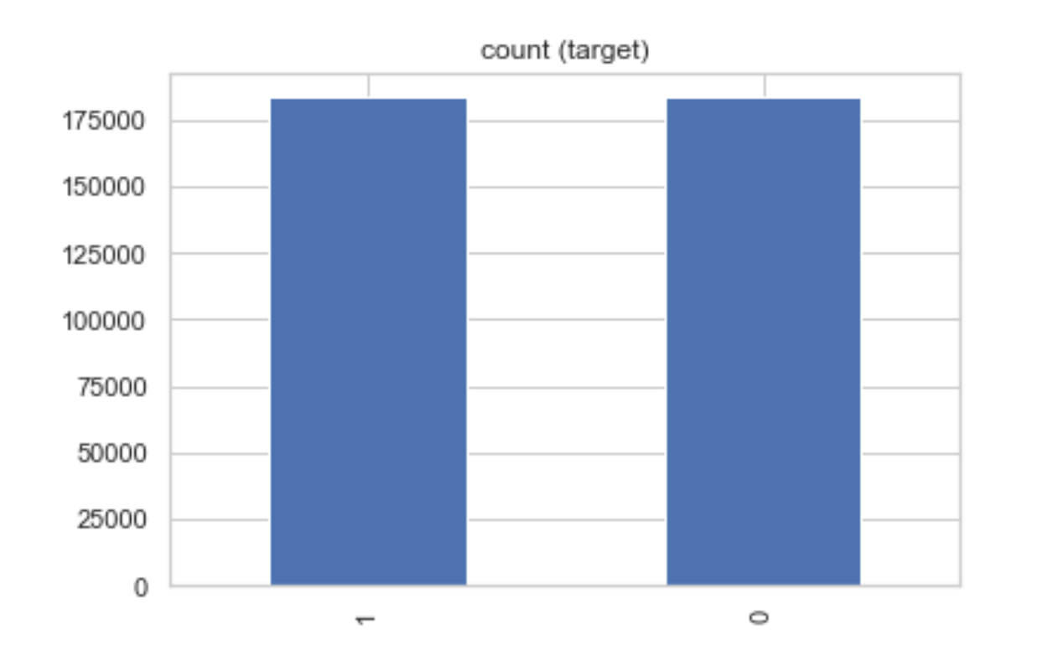
Data Sampling and Feature extraction
Before sampling data was been extracted to get numerical data from categorical data
Later data was been over sampled as we had an imbalance between different classes

Slide 12
Models
There were 4 algorithms used.
RandomForestClassifier
XGBClassifier
GradientBoostingClassifier
DecisionTreeClassifier
Accuracy core and F1 score were used for key performance checking

Slide 13
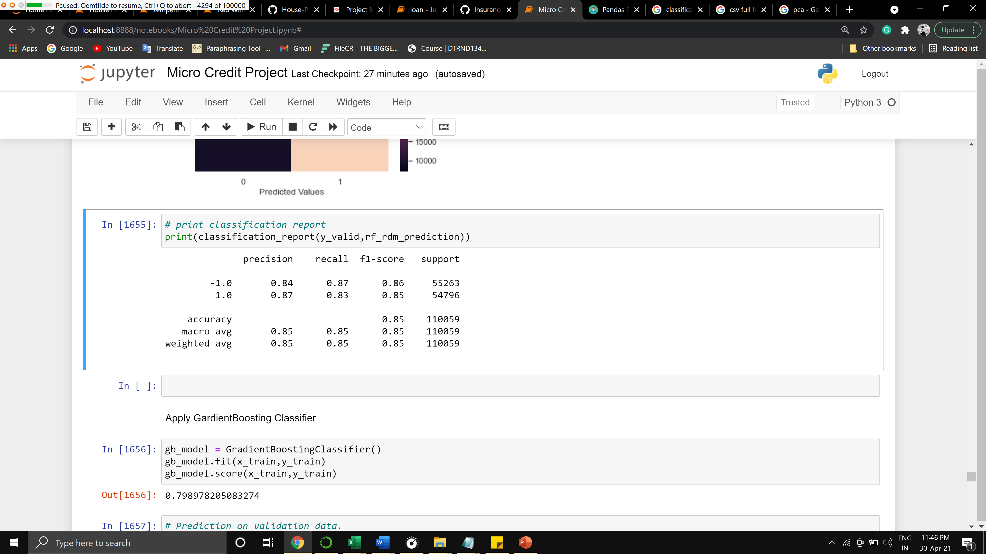
RandomForestClassifier
Before tuning
Accuracy_Score: 0.9663362378360697
roc_auc_score: 0.9662067444755146
After tuning
Accuracy_Score: 0.8517340699079584
roc_auc_score: 0.8516451928321143

Slide 14
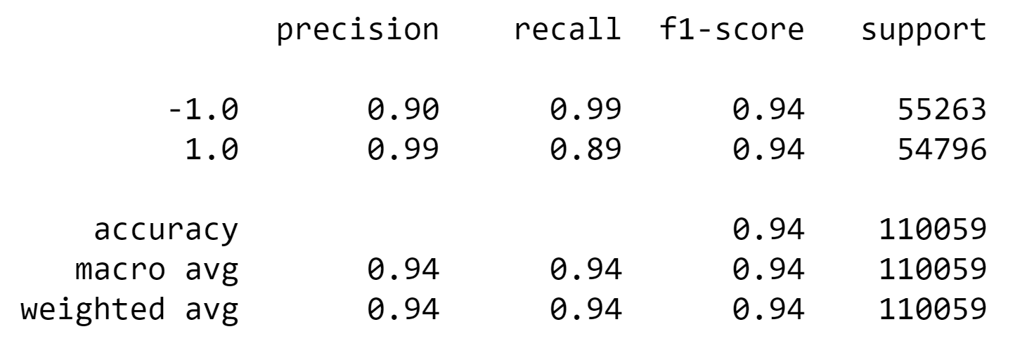
GradientBoostingClassifier
Before tuning
Accuracy_Score: 0.7997892039724148
roc_auc_score: 0.7997975124985397
After tuning
Accuracy_Score: 0.9402047992440419
roc_auc_score: 0.9399974182212741

Slide 15
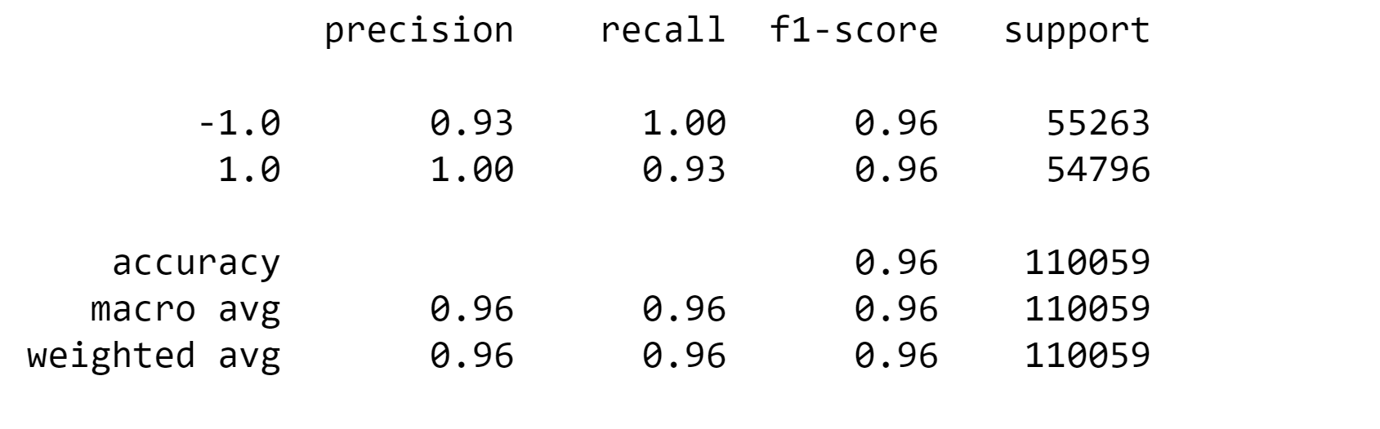
XGBClassifier
Before tuning
accuracy_Score: 0.8483994948164166
roc_auc_score: 0.8482806780676397
After tuning
Accuracy_Score: 0.9627018235673593
roc_auc_score: 0.962557228566522

Slide 16
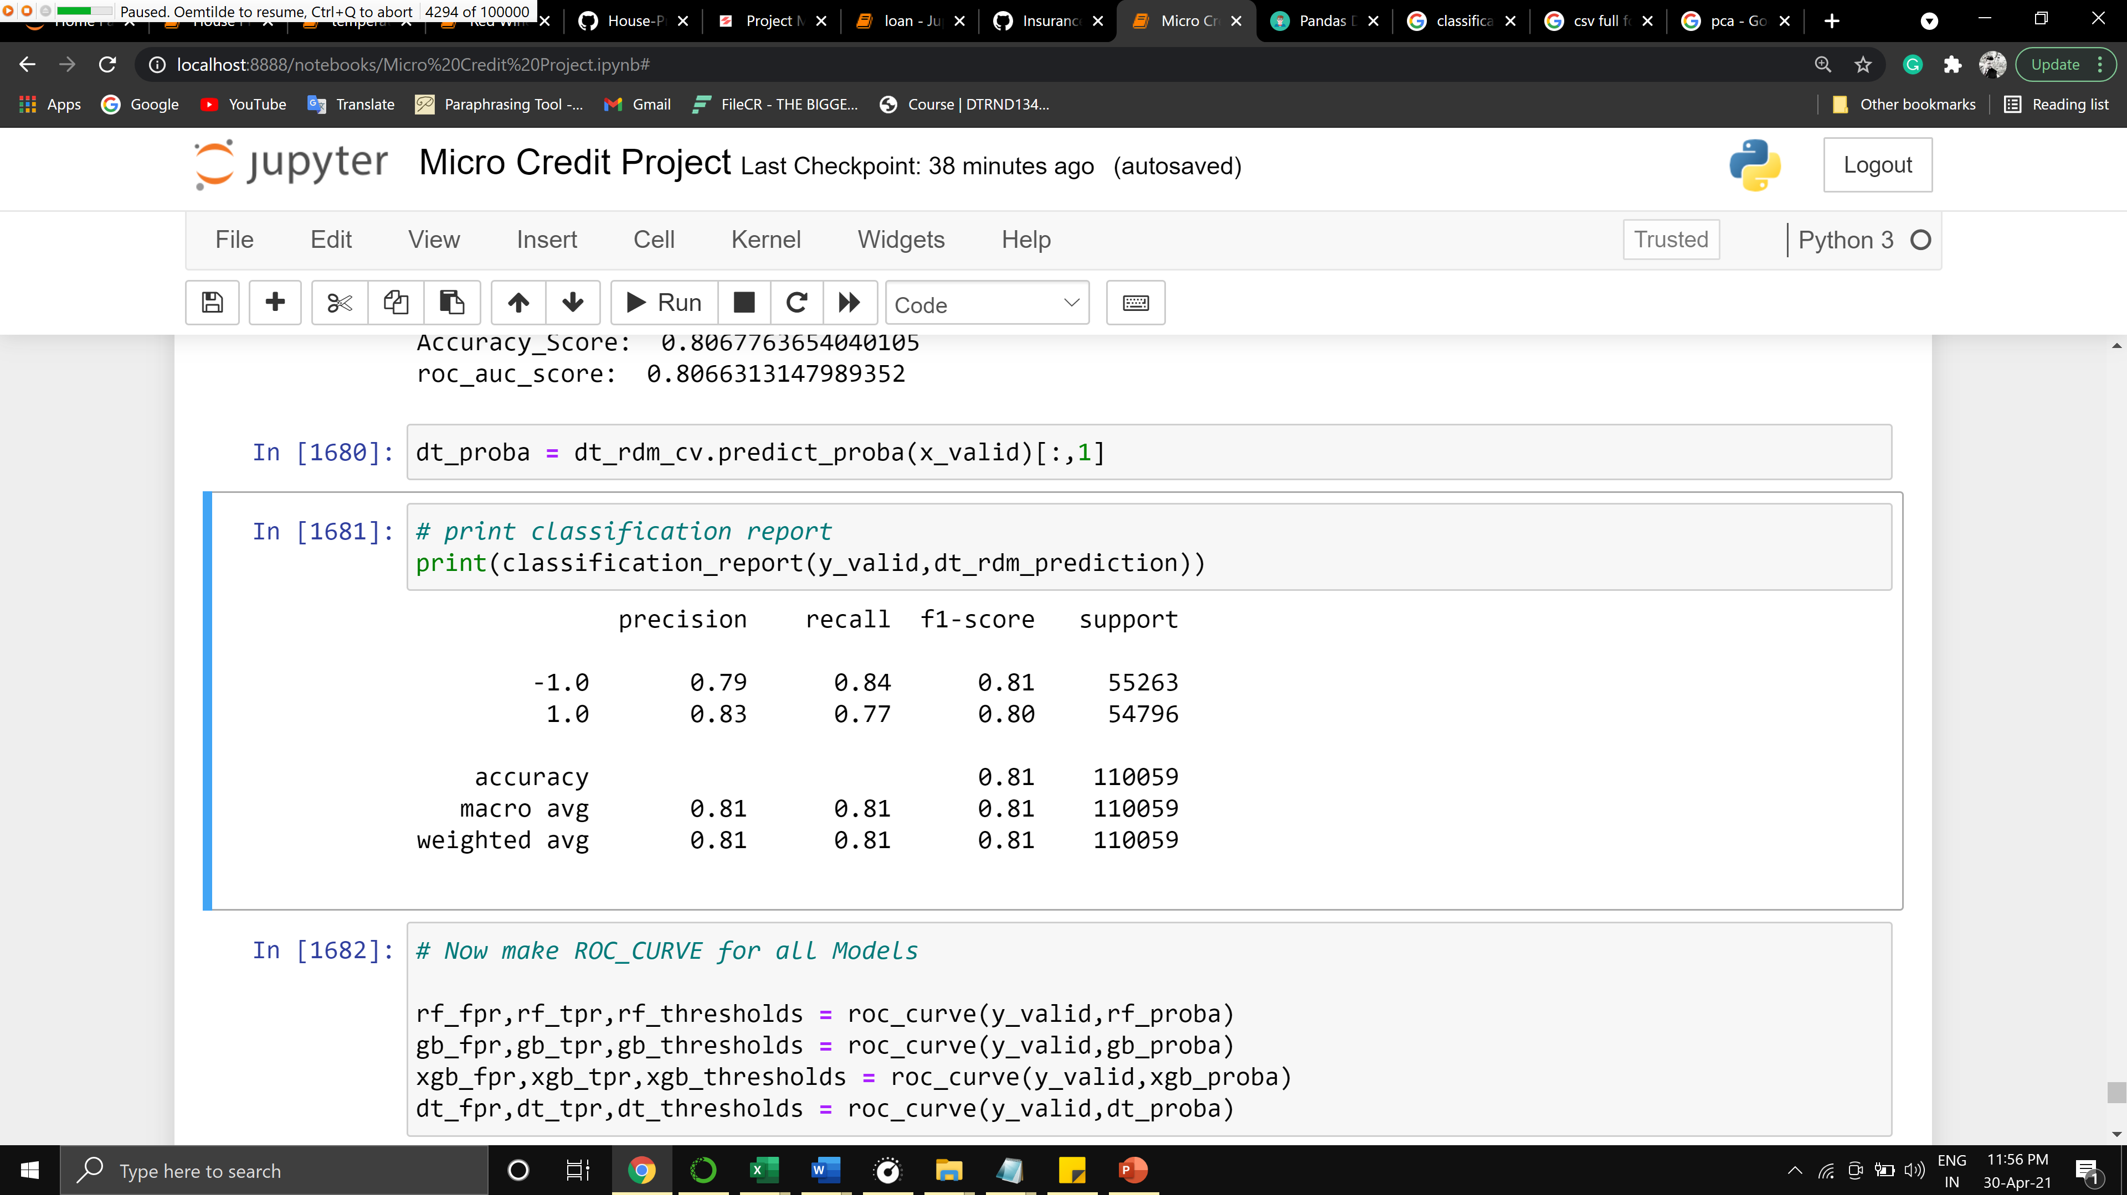
DecisionTreeClassifier
Before tuning
Accuracy_Score: 0.9467830890704076
roc_auc_score: 0.9465699662252651
After tuning
Accuracy_Score: 0.8067763654040105
roc_auc_score: 0.8066313147989352

Slide 17
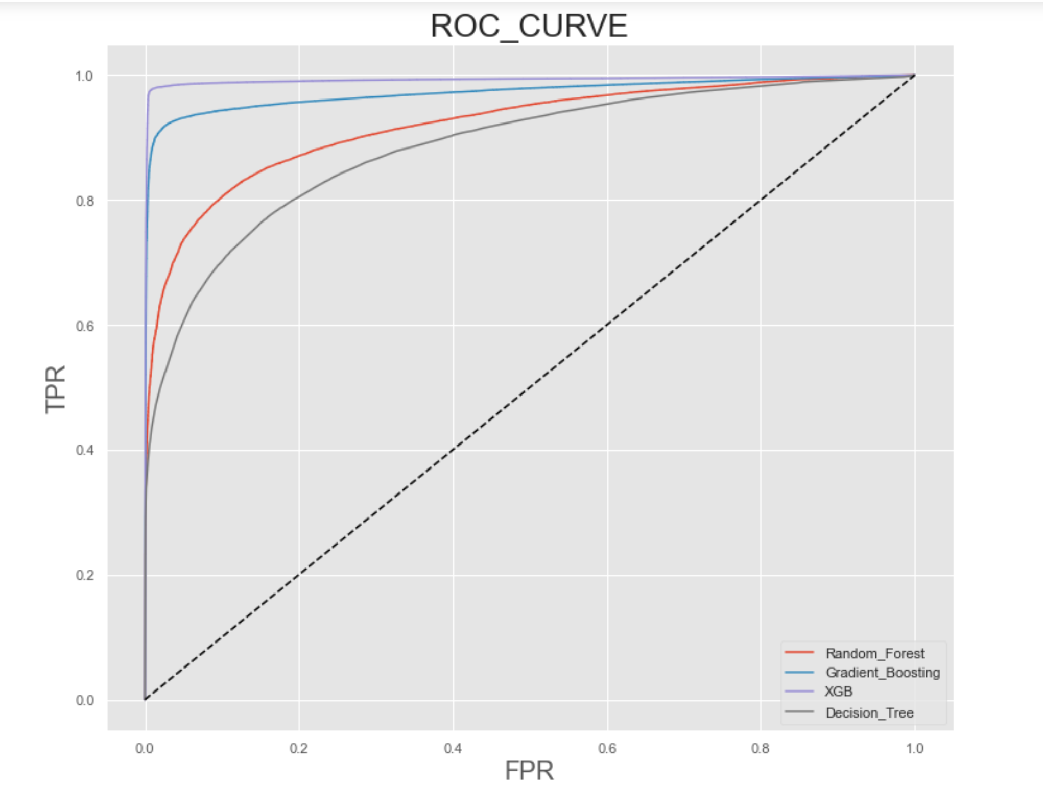
Conclusion
The Ideal Algorithm for this project is XGBClassifier
The score has been increased after tuning
Aslo the Roc Curve shows the performs of this particular Classifier compared to others is the better performer

Slide 18
Thank You

